Slide 1

MANY EYES & TABLEAU PUBLIC & ORANGE Fatma DOGAN CSE6339 Data Science and Computational Journalism 02/20/2015

Slide 2
Overview
Tutorial 1 - Many Eyes
Introduction
Features of Many Eyes
How to Use Many Eyes
Who is using Many Eyes and how?
Demo of Many Eyes
Tutorial 2 - Tableau Public
Introduction
Features of Tableau Public
Why Use Tableau Public?
Who is Tableau Public for?
Some links
Demo of Tableau Public
Tutorial 3 - ORANGE
Introduction
Features of ORANGE
How to downloads
Illustration of How to Use Step by Step
Demo of ORANGE
Notes:
den Toonder, Jaap MJ, and Patrick R. Onck. "Microfluidic manipulation with artificial/bioinspired cilia." Trends in biotechnology 31.2 (2013): 85-91.

Slide 3



Slide 4
Features of Many Eyes
Created by IBM researchers Fernanda B. Viégas and Martin Wattenberg at the Watson Research Center of IBM in Cambridge, Massachusetts.
A social website dedicated to data visualization and analysis.
Members upload collections of data
Then create their visualizations, interpret, discuss, and even re-visualize one another's data.
Those who register at the site can comment on one another’s work.
Almost all the tools are interactive
Users can embed images and links to their visualizations in their Web sites or blogs, just as they can embed YouTube videos.
Source: http://web.archive.org/web/20130729204217id_/http://itc.conversationsnetwork.org/shows/detail3504.html
Notes:
den Toonder, Jaap MJ, and Patrick R. Onck. "Microfluidic manipulation with artificial/bioinspired cilia." Trends in biotechnology 31.2 (2013): 85-91.

Slide 5
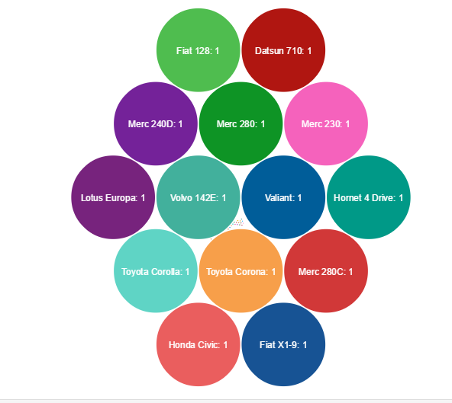
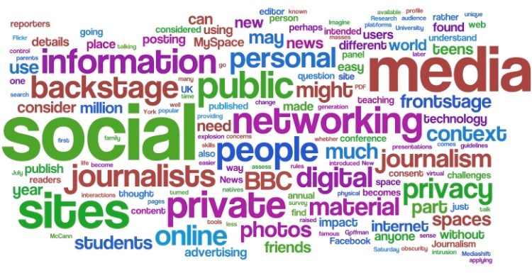
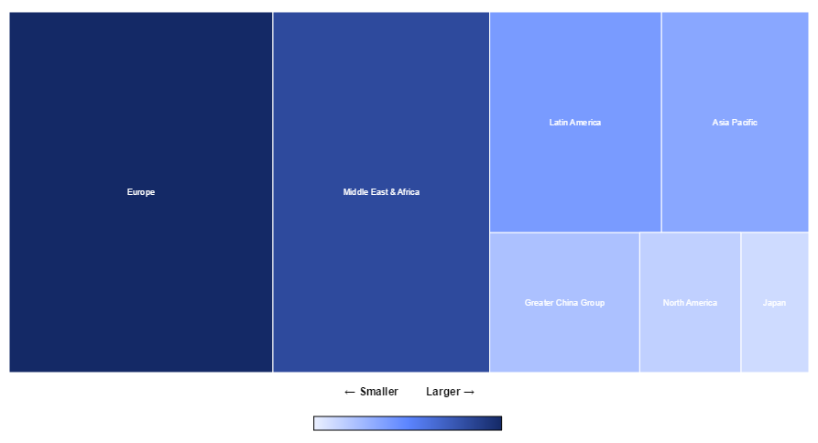
The Many Eyes site offers 15 ways to present data:
Charts (Line chart, Pie Chart, Bar Chart, Bubble Chart, Radar Chart, Chord Chart, Survey Chart, Scatter Chart)
Box Plot
Word Cloud
Heat Map
Tree Map
Maps (Map of United States, Map of Canada, World Map)

Slide 6
How to Use Many Eyes
No programming or technical expertise is needed, so almost everyone has the power to create visualizations. You simply follow three steps:
Upload your public data set. Visualizations created on the Many Eyes website work from simple data formats, such as a spreadsheet or text files.
Select from a wide variety of visualizations or one recommended by Many Eyes.
Unleash your insight by sharing your visualization over the web. You can embed a visualization in your blog or easily share it on Facebook and Twitter.
Source: http://www-01.ibm.com/software/analytics/many-eyes/
Notes:
den Toonder, Jaap MJ, and Patrick R. Onck. "Microfluidic manipulation with artificial/bioinspired cilia." Trends in biotechnology 31.2 (2013): 85-91.

Slide 7
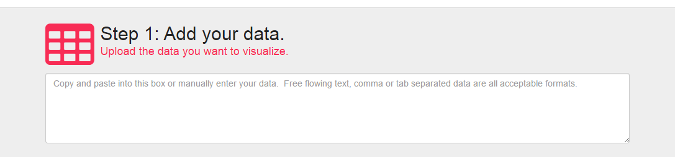
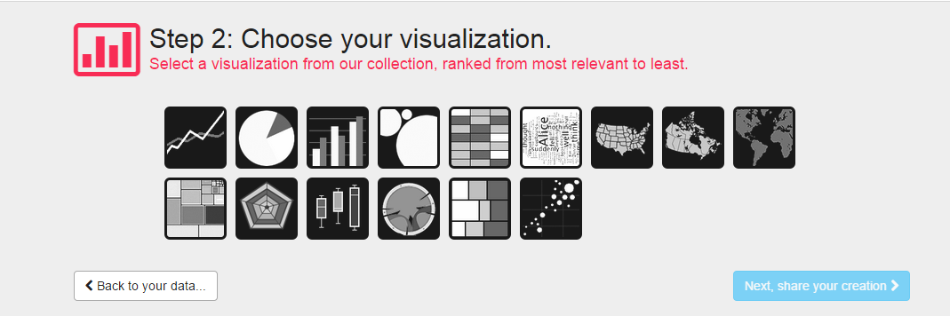

Slide 8
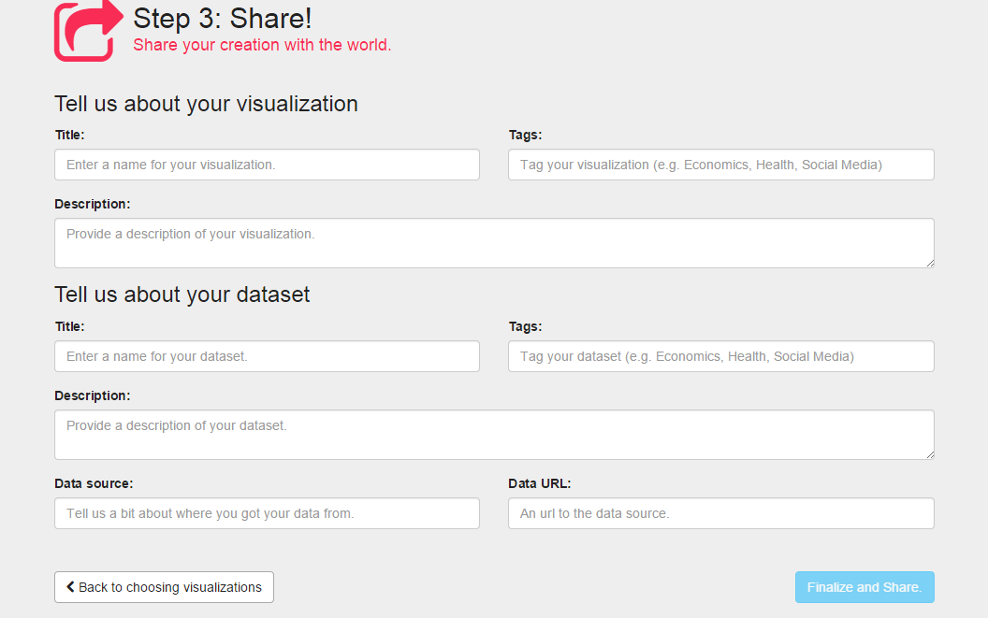

Slide 9
Who is using Many Eyes and how?
Researchers
Climatologists and environmental scientists are using the Many Eyes website to create visualizations about climate change, weather patterns and fuel efficiency. Life scientists are using Many Eyes to develop visualizations about genes, chromosomes and disease patterns.
Advocacy groups
Advocacy groups are creating visualizations on the Many Eyes website to support global social services, policy changes and government reforms around the world.
Journalists
A wide range of journalists, from economics to sports, are using visualizations they created on the Many Eyes website to understand topics such as the stimulus package and major league baseball salaries.
Educators and Students
Educators can produce visualizations on the Many Eyes website that compare college tuition, illustrate student interests and track enrollment patterns.
Notes:
den Toonder, Jaap MJ, and Patrick R. Onck. "Microfluidic manipulation with artificial/bioinspired cilia." Trends in biotechnology 31.2 (2013): 85-91.

Slide 10
DEMO
UT Arlington Student Feedback Survey Summary for CSE Department at 2014 Fall:
http://www-969.ibm.com/software/analytics/manyeyes/#/visualizations?view=201665

Slide 11

All information in these slides related to Tableau Public is taken from http://www.tableau.com/public/

Slide 12
Tableau Public
Tableau Public is a product of Tableau Software, created to make fast analytics and data visualization products.
Founded by an Academy-Award winning professor from Stanford University, Pat Hanrahan.
The technology behind Tableau Public is called VizQL: A Visual Query Language.
VizQL is a computer language for describing tables, graphs, charts, maps, time series, tables of visualizations and dashboards. It unifies all of these different visual representations into a simple language.
VizQL statements define the mapping from records returned from a dataset or database to marks on a visualization (drawing primitives). Some fields in the record are mapped to the geometric properties of the mark, including position, size and orientation; other fields are reflected in visual attributes like color and pattern.
Notes:
den Toonder, Jaap MJ, and Patrick R. Onck. "Microfluidic manipulation with artificial/bioinspired cilia." Trends in biotechnology 31.2 (2013): 85-91.

Slide 13
Why Use Tableau Public?
Free service.
Anyone can do it. You don’t need to be a programmer or hire one.
No programming skills of any kind are required. It is a simple drag and drop process that anyone can easily learn.
No language to learn, no Flash, no plug-ins, no API.
Can create interactive graphs, dashboards, maps and tables from virtually any data and embed them on your website or blog in minutes.
Tableau Public can connect to Microsoft Excel, Microsoft Access, and multiple text file formats. It has a limit of 1,000,000 rows of data that is allowed in any single file.
Notes:
den Toonder, Jaap MJ, and Patrick R. Onck. "Microfluidic manipulation with artificial/bioinspired cilia." Trends in biotechnology 31.2 (2013): 85-91.

Slide 14
Who is Tableau Public for?
The free version of Tableau Public is for everyone.
writers,
bloggers,
students,
professors,
hobbyists,
journeymen,
critics,
citizens and more.
It’s also meant for organizations, but only as an introductory service
Notes:
den Toonder, Jaap MJ, and Patrick R. Onck. "Microfluidic manipulation with artificial/bioinspired cilia." Trends in biotechnology 31.2 (2013): 85-91.

Slide 15
How does Tableau Public work?
Tableau Public includes a free desktop product that you can download and use to publish interactive data visualizations to the web.
The Tableau Public desktop saves work to the Tableau Public web servers – nothing is saved locally on your computer.
There is a 1 gigabyte limit on storage space for data.
All content saved to Tableau Public is accessible to everyone on the internet. As the author, you are the only one who can delete your own content, but anyone on the internet can view it.
In addition to viewing it, anyone can download a copy of your workbook (including the underlying data) as well, which will let them work with and build upon your original.
Notes:
den Toonder, Jaap MJ, and Patrick R. Onck. "Microfluidic manipulation with artificial/bioinspired cilia." Trends in biotechnology 31.2 (2013): 85-91.

Slide 16
Tableau Public is compatible with following online blog services.
Embedding Tableau Public content into a blog requires the blog software to support embedded html content, including script tags. Some popular blog sites which are compatible with Tableau Public embedded content are:
Blogger (by Google) – www.blogger.com
Typepad – www.typepad.com Edit your posts in HTML mode rather than Rich Text, otherwise the Tableau Public embed codes don’t get preserved.
Wordpress - www.wordpress.org. On this site you can download and install a software script called WordPress. To do this you need a web host. WordPress is completely customizable and can be used for almost anything.
Notes:
den Toonder, Jaap MJ, and Patrick R. Onck. "Microfluidic manipulation with artificial/bioinspired cilia." Trends in biotechnology 31.2 (2013): 85-91.

Slide 17
Download Tableau Public from: http://www.tableausoftware.com/public/download-steps
Create a Tableau Public account at: https://public.tableausoftware.com/auth/signup
Useful Links
Training videos
http://www.tableau.com/public/training
How to embed youtube videos in tableau public
http://dataremixed.com/2013/04/embedding-youtube-videos-in-tableau/
How to embed a google map in tableau public
http://dataremixed.com/2013/06/how-to-embed-a-google-map-in-tableau/
Notes:
den Toonder, Jaap MJ, and Patrick R. Onck. "Microfluidic manipulation with artificial/bioinspired cilia." Trends in biotechnology 31.2 (2013): 85-91.

Slide 18
DEMO

Slide 19

All information in these slides related to Orange taken from http://orange.biolab.si/

Slide 20

ORANGE
Orange is a comprehensive, component-based software suite for machine learning and data mining, developed at Bioinformatics Laboratory, Faculty of Computer and Information Science, University of Ljubljana, Slovenia, together with open source community.
Notes:
den Toonder, Jaap MJ, and Patrick R. Onck. "Microfluidic manipulation with artificial/bioinspired cilia." Trends in biotechnology 31.2 (2013): 85-91.

Slide 21
Features of Orange
Open source and free
Platform independent
Support visual programming tools for data mining
Python Scripting Interface
Support component for machine learning
Add-ons for bioinformatics, networks, and text mining
Notes:
den Toonder, Jaap MJ, and Patrick R. Onck. "Microfluidic manipulation with artificial/bioinspired cilia." Trends in biotechnology 31.2 (2013): 85-91.

Slide 22
Download
Orange is supported on
Windows
Mac OS X
Linux/Source
For Developers
Download installer from http://orange.biolab.si/download/
Orange installer
Requires Python 2.6 or 2.7
Includes NumPy, SciPy, PyQt, other required libraries
Notes:
den Toonder, Jaap MJ, and Patrick R. Onck. "Microfluidic manipulation with artificial/bioinspired cilia." Trends in biotechnology 31.2 (2013): 85-91.

Slide 23
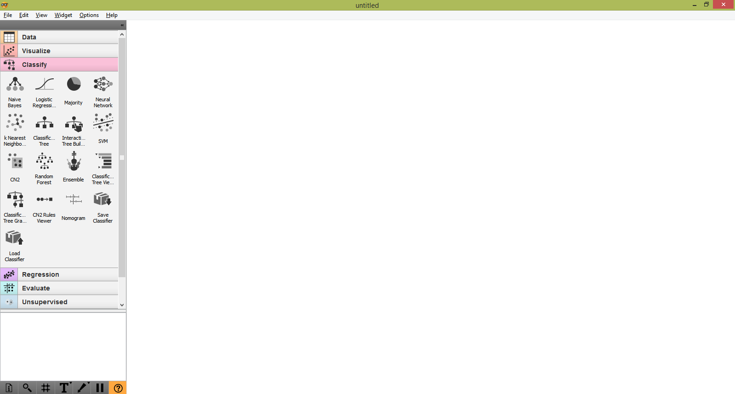
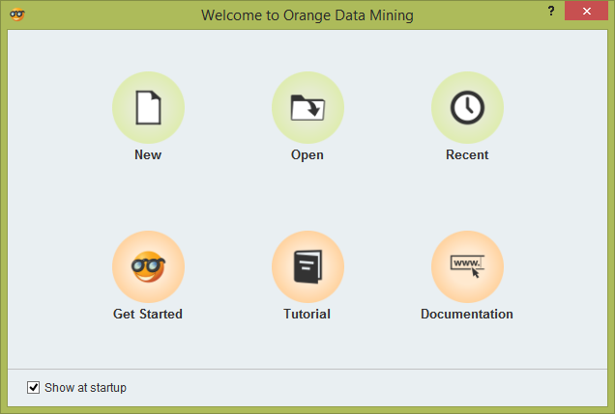
Welcome to Orange
Notes:
den Toonder, Jaap MJ, and Patrick R. Onck. "Microfluidic manipulation with artificial/bioinspired cilia." Trends in biotechnology 31.2 (2013): 85-91.

Slide 24
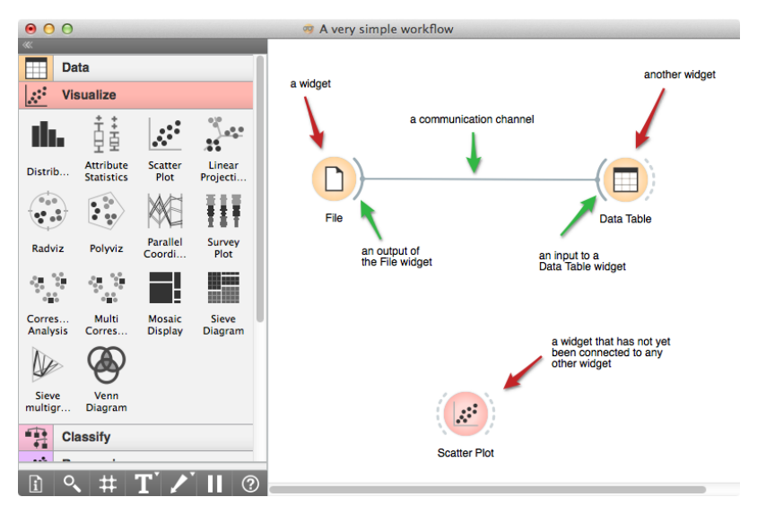
Workflow in Orange
Orange widgets are building blocks of data analysis workflows that are assembled in Orange’s visual programming environment.
Widgets are grouped into classes according to their function. A typical workflow may mix widgets for data input and filtering, visualization, and predictive data mining.
Image source: http://docs.orange.biolab.si/_downloads/bio-tutorial.pdf
Notes:
den Toonder, Jaap MJ, and Patrick R. Onck. "Microfluidic manipulation with artificial/bioinspired cilia." Trends in biotechnology 31.2 (2013): 85-91.

Slide 25
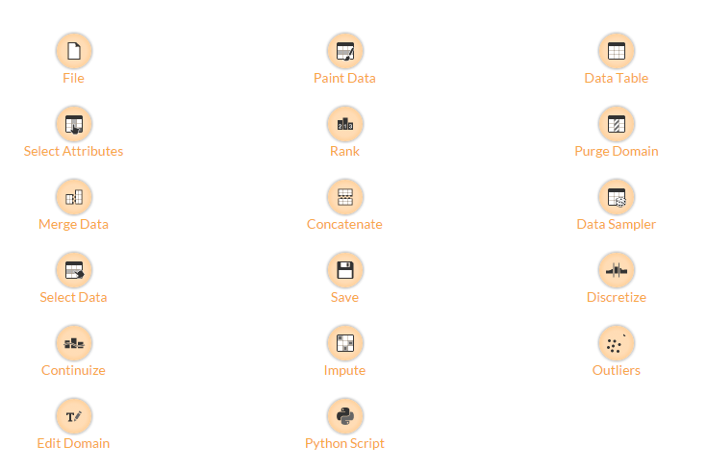
Data Widgets
Notes:
den Toonder, Jaap MJ, and Patrick R. Onck. "Microfluidic manipulation with artificial/bioinspired cilia." Trends in biotechnology 31.2 (2013): 85-91.

Slide 26
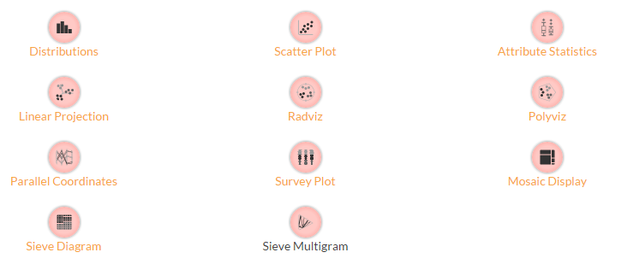
Visualize Widgets
Notes:
den Toonder, Jaap MJ, and Patrick R. Onck. "Microfluidic manipulation with artificial/bioinspired cilia." Trends in biotechnology 31.2 (2013): 85-91.

Slide 27
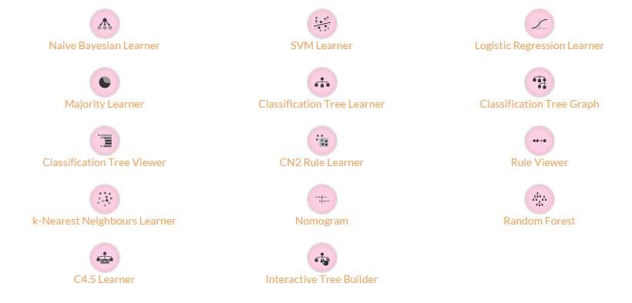
Classify Widgets
Notes:
den Toonder, Jaap MJ, and Patrick R. Onck. "Microfluidic manipulation with artificial/bioinspired cilia." Trends in biotechnology 31.2 (2013): 85-91.

Slide 28
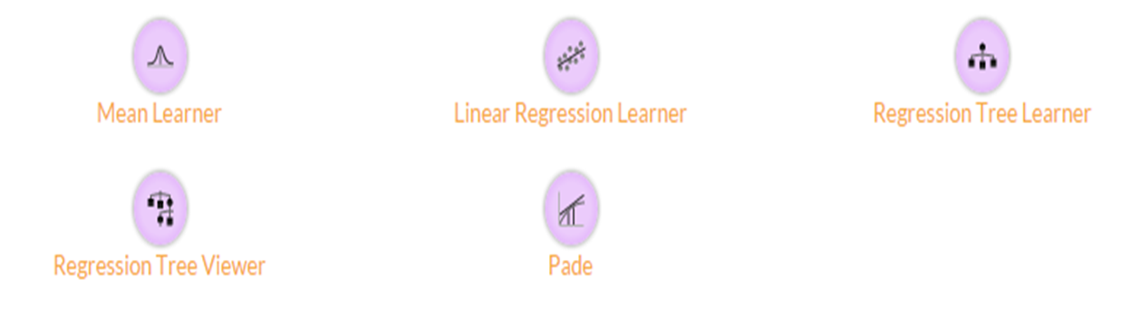
Regression Widgets
Notes:
den Toonder, Jaap MJ, and Patrick R. Onck. "Microfluidic manipulation with artificial/bioinspired cilia." Trends in biotechnology 31.2 (2013): 85-91.

Slide 29
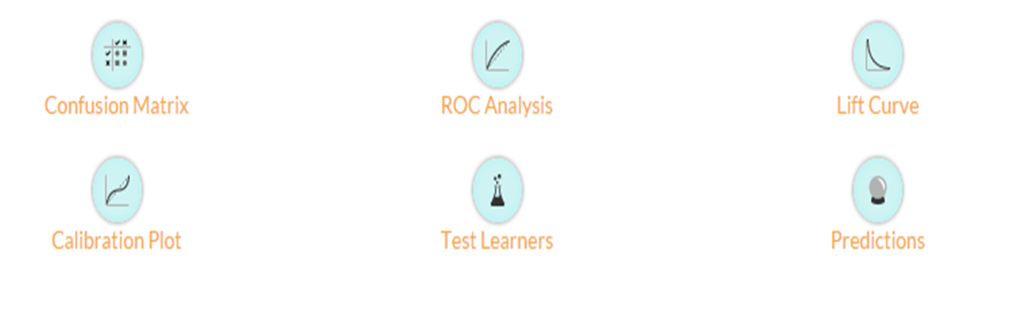
Evaluate Widgets
Notes:
den Toonder, Jaap MJ, and Patrick R. Onck. "Microfluidic manipulation with artificial/bioinspired cilia." Trends in biotechnology 31.2 (2013): 85-91.

Slide 30
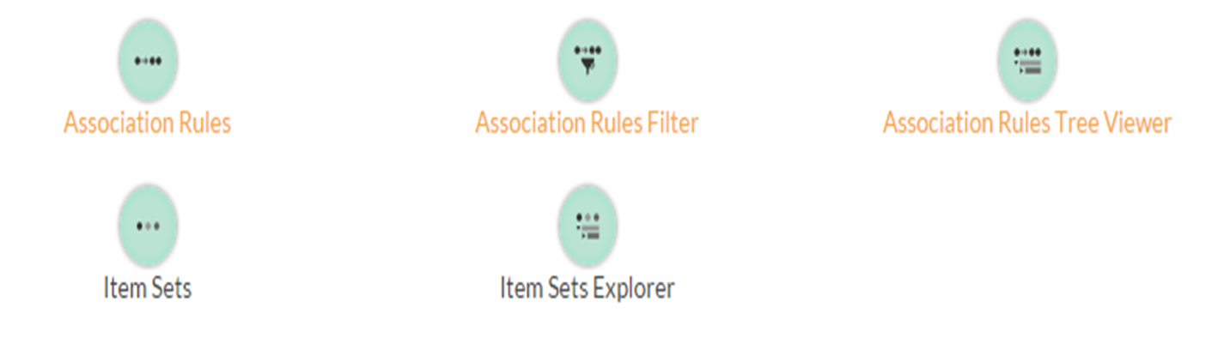
Associate Widgets
Notes:
den Toonder, Jaap MJ, and Patrick R. Onck. "Microfluidic manipulation with artificial/bioinspired cilia." Trends in biotechnology 31.2 (2013): 85-91.

Slide 31
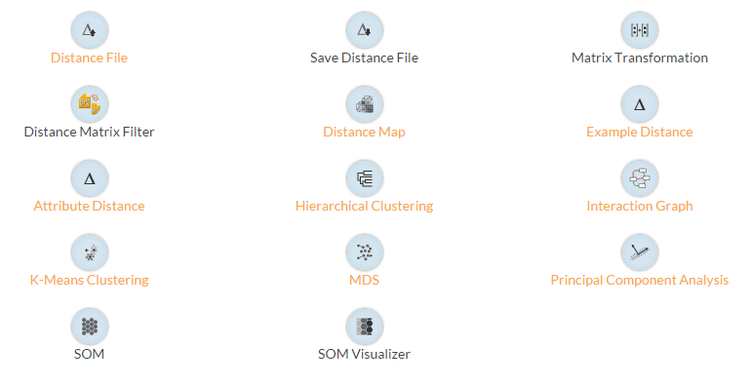
Unsupervised
Notes:
den Toonder, Jaap MJ, and Patrick R. Onck. "Microfluidic manipulation with artificial/bioinspired cilia." Trends in biotechnology 31.2 (2013): 85-91.

Slide 32
DEMO

